Slide 1
Unit: Organic Materials: Structure & Function
Subject Matter:
explain how the properties of polymers depends on their structural features including; the degree of branching in polyethene (LDPE and HDPE), the position of the methyl group in polypropene (syntactic, isotactic and atactic) and polytetrafluorethene.

Slide 2
Synthetic and Biological Polymers
Polymers: Macromolecules formed by the covalent attachment of a set of small molecules termed monomers.
Polymers are classified as:
(1) Man-made or synthetic polymers that are synthesized in the laboratory;
(2) Biological polymer that are found in nature.
Synthetic polymers: nylon, poly-ethylene, poly-styrene
Biological polymers: DNA, proteins, carbohydrates

Slide 3
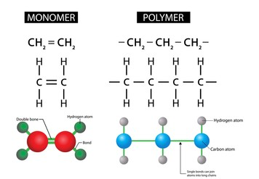

Slide 4
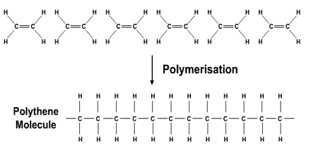

Slide 5
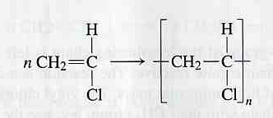
Methods for making polymers
Addition polymerization and condensation polymerization
Addition polymerization: monomers react to form a polymer without net loss of atoms.
Most common form: free radical chain reaction of ethylenes
n monomers
one polymer molecule

Slide 6
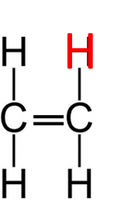
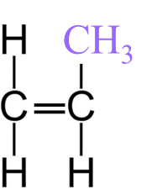
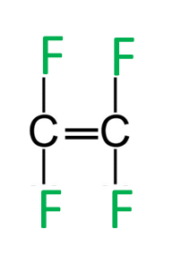
explain how the properties of polymers depends on their structural features including; the degree of branching in polyethene (LDPE and HDPE), the position of the methyl group in polypropene (syntactic, isotactic and atactic) and polytetrafluorethene.
Polymers
Substances that consist of thousands of small molecules called monomers, linked together.
 | Monomer | Polymer (PLASTICS)
Ethene |  | Polyethene Commonly known as: Polyethylene
Propene |  | Polypropene Commonly known as: Polypropylene
Tetrafluoroethene |  | Polyterafluoroethene Commonly known as: Teflon
* Notice the changing of the side chain. It will determine properties of the polymer.

Slide 7
explain how the properties of polymers depends on their structural features including; the degree of branching in polyethene (LDPE and HDPE), the position of the methyl group in polypropene (syntactic, isotactic and atactic) and polytetrafluorethene.
Factors that affect the properties of a polymer:
Chain length
Increase in chain length increases the number of intermolecular forces
Increases the melting and boiling points.
Functional groups
Changing the functional groups changes the intermolecular forces.
weakest London (dispersion), dipole-dipole, hydrogen bonding strongest
Degree of branching
Increasing the branching lowers the intermolecular forces.
This decreases the melting and boiling points.
Alignment
Packing the molecules closer together allows for more intermolecular force interactions.

Slide 8
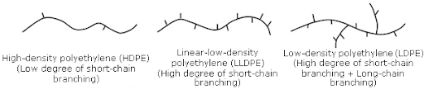
explain how the properties of polymers depends on their structural features including; the degree of branching in polyethene (LDPE and HDPE), the position of the methyl group in polypropene (syntactic, isotactic and atactic) and polytetrafluorethene.
Name and structure | Degree of branching | Intermolecular force. | Properties and uses
High density polyethene (HDPE) | Low degree | Non-polar so London (dispersion) forces. | Stronger and less flexible due to the tightly packed molecules allowing for many London (dispersion) forces Uses: Pipes, buckets, toys, fuel tanks.
Low density polyethene (HDPE) | High degree | Non-polar so London (dispersion) forces. | Slightly weaker and more flexible due to less London (dispersion) forces because molecules are spaced. Uses: Plastic wrap, squeeze bottles.

Slide 9


Slide 10
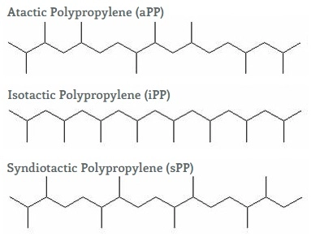
explain how the properties of polymers depends on their structural features including; the degree of branching in polyethene (LDPE and HDPE), the position of the methyl group in polypropene (syndiotactic, isotactic and atactic) and polytetrafluorethene.
Name and structure | Structure description | Uses
Isotactic polypropene | Regular orientation of methyl group allows crystalline regions to form that have relatively strong attractive forces between the chains. | Strong ropes and fibres, babies bottles.
Atactic polypropene | Random orientation of the methyl group causes amorphous sections (non crystalline) which makes it very soft. | Limited uses.
Syndiotactic polypropene | The alternating methyl group arrangement produces highly crystalline material with relatively strong intermolecular forces between chains. | New Polymer so uses being explored.

Slide 11
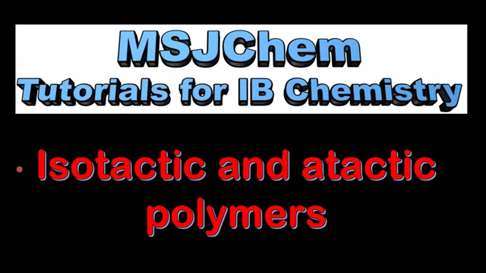

Slide 12
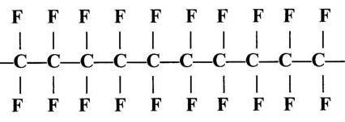
explain how the properties of polymers depends on their structural features including; the degree of branching in polyethene (LDPE and HDPE), the position of the methyl group in polypropene (syntactic, isotactic and atactic) and polytetrafluorethene.
Name and structure | Degree of branching | Intermolecular force. | Properties and uses
polyterafluoroethene | Low degree | Fluorine are small and highly electronegative. MUCH stronger London (dispersion) forces. | Fluorine has non-stick properties and high melting point. Uses: Frying pan, iron coatings

Slide 13
WORKSHEET

